Slide 1
RTE Framework for Schools – 2012
Presented by: Ekta Sharma

Slide 2
Component of presentation
Introduction
Objectives of the RTE Framework
Key Provisions under the RTE Act
The 2012 Framework Overview
School Infrastructure Requirements
Teacher Qualifications and Training
Role of School Management Committees (SMCs)
Inclusion and Equity
Child Rights and Protection
Curriculum and Evaluation
Challenges in Implementation
Future Steps
Conclusion

Slide 3


Slide 4
Introduction What is RTE? The Right of Children to Free and Compulsory Education Act or Right to Education Act (RTE) , which was passed by the Indian parliament on 4 August 2009, describes the modalities of the provision of free and compulsory education for children between 6 to 14 in India under Article 21A of the Indian Constitution. India became one of 135 countries to make education a fundamental right for every child when the act came into force on 1 April 2010.

Slide 5
Objectives of the RTE Framework
Ensure every child (6–14 years) receives free and compulsory education.
Improve access and reduce dropout rates.
Promote inclusive and equitable quality education.
Strengthen school management and accountability systems.
Develop child-centered, activity-based learning processes.

Slide 6
Key Provisions under the RTE Act
Free and compulsory education for all children aged 6–14 years.
No child shall be held back, expelled, or required to pass a board exam until completion of elementary education.
Reservation of 25% seats in private schools for disadvantaged children.
Norms and standards for teacher qualification and pupil-teacher ratio (PTR).

Slide 7
School Infrastructure Requirements
Adequate classrooms, toilets, drinking water, playgrounds.
Barrier-free access for children with disabilities.
Libraries and teaching-learning materials.
Compliance with minimum standards as per Schedule of the RTE Act.

Slide 8
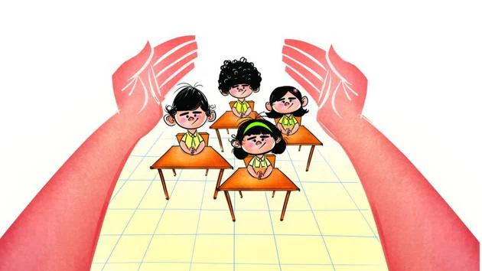

Slide 9
Teacher Qualifications and Training
Teachers must meet NCTE norms.
Continuous professional development and in-service training.
Focus on child-centered pedagogy and inclusive practices.
Use of innovative teaching methods and ICT tools.

Slide 10
Role of School Management Committees (SMCs)
75% members from parents and local community.
Prepare and monitor School Development Plans (SDP).
Make and check the School Development Plan.
Promote community participation and transparency.
Support better communication between teachers and parents.

Slide 11
Inclusion and Equity
Equal opportunities for all children regardless of caste, gender, religion, or disability.
Special provisions for marginalized groups and differently-abled children.
Gender-sensitive and inclusive classroom practices.

Slide 12
Child Rights and Protection
Prohibition of physical punishment and mental harassment.
Safe, secure, and child-friendly school environment.
No discrimination or segregation within schools.
Special Training for Drop-outs
Reservation for Disadvantaged Groups

Slide 13
Curriculum and Evaluation
Follow National Curriculum Framework (NCF 2005).
Focus on understanding, not memorizing.
Use Continuous and Comprehensive Evaluation (CCE).
Make learning enjoyable and stress-free.
Emphasis on holistic development and learning outcomes.

Slide 14
Challenges in Implementation
Shortage of trained teachers and infrastructure gaps.
Lack of basic facilities in some schools..
Weak monitoring and data management.
Low community participation in SMCs.
Less awareness among parents

Slide 15
Future Steps
Strengthen teacher training and digital literacy.
Improve infrastructure through local partnerships.
Enhance accountability and data transparency.
Foster inclusive and innovative learning practices.
Focus on quality and joyful learning
Train more teachers and use technology in teaching.

Slide 16
Conclusion
The RTE Framework (2012) is a landmark initiative for universalizing elementary education.
Its success depends on collaboration between teachers, communities, and government bodies to ensure every child learns with dignity and quality.

Slide 17
Thank you

